Slide 1
DM 2 – Lecture 1b
A Deeper Dive into Perceptrons and Neural Networks
A. Breitzman 9/5/2018

Slide 2
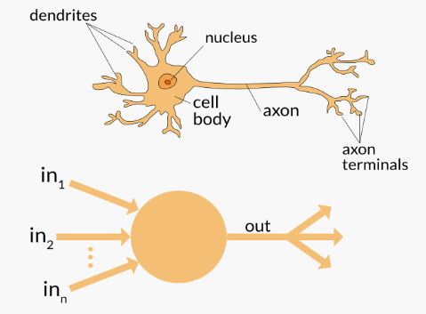
Background
Since the beginning of AI computer scientists assumed the key to machine learning was to build a machine that acted like the human brain
Never mind that in the 1950’s (as well as today) the brain wasn’t very well understood
The idea was that the brain was filled with neurons so if we could mimic the behavior of neurons in a machine we could achieve machine learning

Slide 3
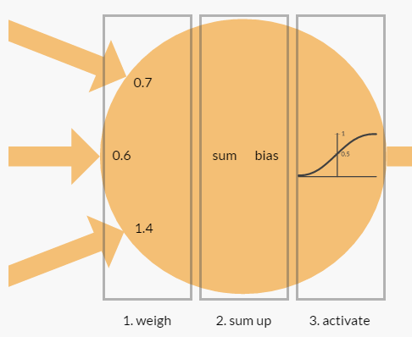
Zooming In
We input several (scaled) inputs that get multiplied by various weights
Those weighted inputs are summed along with an external bias weight
It goes through an activation function and returns a value between 0 and 1.0
The output may get unscaled to return: bad, ok, good, excellent, etc.
As we saw last semester the magic occurs in the back-propogation algorithm which adjusts the weights
This is shown as a black box, but we also showed how those weights could be created in R and then exported to Excel or some other program for use in an embedded system or custom program or machine
Picture from from https://appliedgo.net/perceptron/

Slide 4
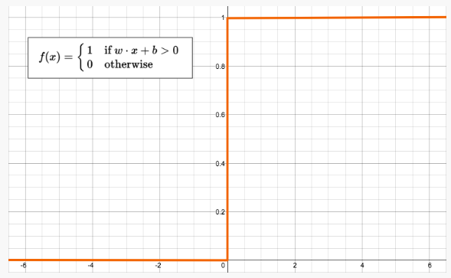
Perceptron
The activation function on the previous page is a sigmoid function. (see my DM 1 notes for the equation)
Another popular activation function is Tanh
The one to the left will be recognized by physicists and mathematicians as the heaviside function.
An artificial neuron that uses the heaviside activation function is called a perceptron, which is the simplest type of neural network
Perceptrons were introduced by Minsky and Papert (late 1950s)
Perceptron convergence theorem Rosenblatt 1962: Perceptron will learn to classify any linearly separable set of inputs. (see next slide)
Picture from from https://appliedgo.net/perceptron/

Slide 5
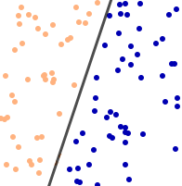
Linearly Separable
Recall Titanic Project from last semester
Each passenger was a vector with something like 10 attributes
We’re trying to predict survival or not
The inputs would be the 10 values and if the activation function returned 1 we would say passenger survived and if it returned 0 well…
Note that even a vector with 10 dimensions can be projected onto a 2 dimensional plane like the one to the left
If we can draw a line between survival and not we would say that the set is linearly separable
It was shown in 1962 that if we had a set that was linearly separable, then a perceptron could model the problem and learn a solution
Picture from from https://appliedgo.net/perceptron/

Slide 6
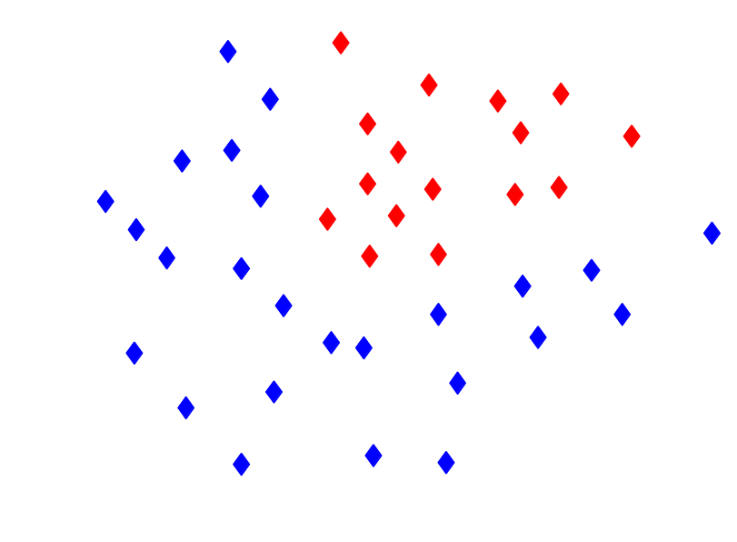
What do we do with something like this?
Clearly not linearly separable!
But separable by a non-linear curve. Right?
Any bright ideas?

Slide 7
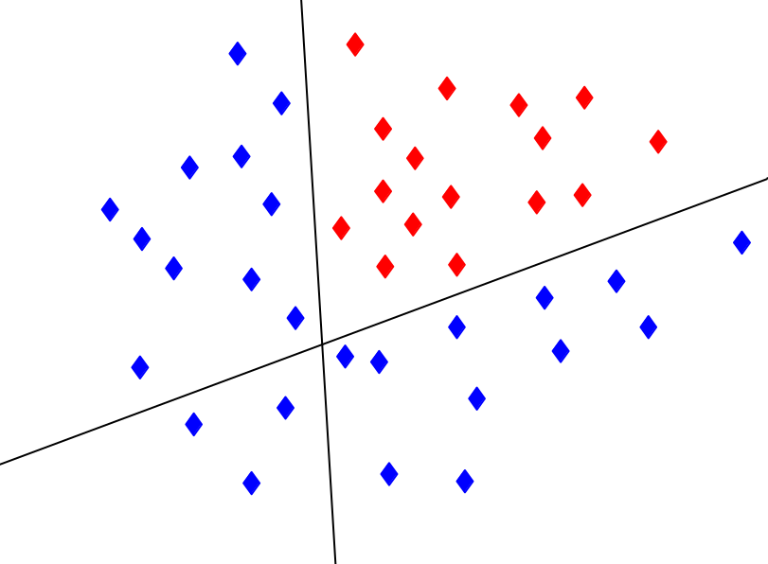
Combine the outputs of 2 perceptrons to solve this one
By using more and more perceptrons we can imitate fairly elaborate curves

Slide 8
The Feed Forward Neural Network
Picture from from https://appliedgo.net/perceptron/
This picture (similar to what you printed out from R last semester) is a typical Feed Forward Neural Network combining a hidden layer of essentially 3 perceptrons.
The input layer in this case only has 2 inputs but it could have as many as we want
Similarly the output layer contains a number between 0 and 1 but that can be scaled or unscaled to predict as many categories as we want

Slide 9
Build a Human Brain?
So if we can combine a bunch of perceptrons together we ought to be able to build a human brain right?
Maybe… For example it’s easy to see that a bunch of perceptrons can be implemented on a massively parallel machine to make it quick
On the other hand human brains have 10¹¹ neurons and 10¹⁴ connections

Slide 10
Quick History
Perceptrons introduced late 1950s
It was shown that they could be trained on linear separable sets in 1962
It was shown that many perceptrons could be combined to predict non-linear phenomen, however no training model could be found
The basic problem for those who know calculus is that a non-linear curve has many local minimums and maximums so potential algorithms got stuck
NN research essentially stopped until the 1970s
Back Propagation invented in 1970’s
(see http://people.idsia.ch/~juergen/who-invented-backpropagation.html for a convoluted history)
We saw last semester that Back Propagation uses gradients (from Calc III) to update the weights of a Neural Network

Slide 11
Implementing a Neural Network
Last semester we mostly used R
If you hate R and like Python you can implement one in about 10 lines of code using Sci-Kit learn
See http://scikit-learn.org/stable/modules/neural_networks_supervised.html
Go to sciKitLearnBreastCancer.doc
This uses the Wisconsin Breast Cancer file which can be found at the UCI machine learning repository https://archive.ics.uci.edu/ml/datasets/Breast+Cancer+Wisconsin+(Diagnostic)
It contains 569 cases with 10 properties and a target consisting of 1 for malignant or 0 for benign

Slide 12
Redo in R
Go to breastCancer1.doc

Slide 13
K-Fold Cross Validation
The original sample is randomly partitioned into k equal sized subsamples.
Of the k subsamples, k-1 are used for training and a single subsample is retained as the test data.
The cross-validation process is then repeated k times (the folds), with each of the k subsamples used exactly once as the validation data.
The k results from the folds can then be averaged to produce a single estimation.
The advantage of this method over repeated random sub-sampling is that all observations are used for both training and validation, and each observation is used for validation exactly once.
For example in the last case where we used 80% of the data for training and 20% for testing, we might use 5-fold cross validation where we break the original data into 5 folds containing random samples of 20% of the data
Sometimes people do random subsampling (also called Monte Carlo Validation, but there is no guarantee that every data point is used and some data points may be used multiple times)

Slide 14
K-Fold Cross Validation (II)
How do we get random folds yet make sure each data point is used only once?
In R you can use the ‘caret’ package, but we will do it old school in 4FoldsExample.pdf

Slide 15
More on Hidden Layers/Hidden Nodes
It has been shown that one hidden layer with the ‘right’ number of hidden nodes will perform as well as multiple hidden layers
R example:
nnet<-neuralnet(formula,trainingData, hidden=64, threshold=0.1)
uses a single hidden layer with 64 hidden nodes. It might be faster to use 2 hidden layers with 40 and 20 nodes respectively. In R we would use hidden=c(40,20) in this case
There are various rules of thumb for picking the best number of hidden nodes/layers
Some will be explored in next slides

Slide 16
Rules of Thumb You Might Try
Make the number of hidden nodes = abs(inputs – outputs)
It is rare to have more than two hidden layers in a neural network. The number of layers will usually not be a parameter of your network you will worry much about. Although multi-layer neural networks with many layers can represent deep circuits, training deep networks has always been seen as somewhat of a challenge. Until very recently, empirical studies often found that deep networks generally performed no better, and often worse, than neural networks with one or two hidden layers. http://yann.lecun.com/exdb/publis/pdf/bengio-lecun-07.pdf
Sqrt(Inputs + outputs)
Use 2 hidden layers. First layer uses (2/3)*(inputs + outputs), second layer uses (1/3)*(inputs + outputs)
number of hidden layers equals one; and (ii) the number of neurons in that layer is the mean of the neurons in the input and output layers.
If you find any others that are interesting. Let me know. I’m kind of a collector of rules of thumb for NNs

Slide 17
Matt Long Research Notes from an Earlier Semester
how many hidden layers?
a model with zero hidden layers will resolve linearly separable data. So unless you already know your data isn't linearly separable, it doesn't hurt to verify this--why use a more complex model than the task requires? If it is linearly separable then a simpler technique will work, but a Perceptron will do the job as well.
The NN FAQ (see slide after next) claims any Rule of thumb for Neural Networks is nonsense since they ignore noise in the data, number of training iterations and a host of other unknowns.
The proper way to adjust hidden layers and hidden nodes: During your model building, test obsessively; testing will reveal the signatures of "incorrect" network architecture. For instance, if you begin with an NN having a hidden layer comprised of a small number of nodes (which you will gradually increase as needed, based on test results) your training and testing (generalization) error will both be high caused by bias and underfitting. Then increase the number of nodes in the hidden layer, one at a time, until the generalization error begins to increase, this time due to overfitting and high variance

Slide 18
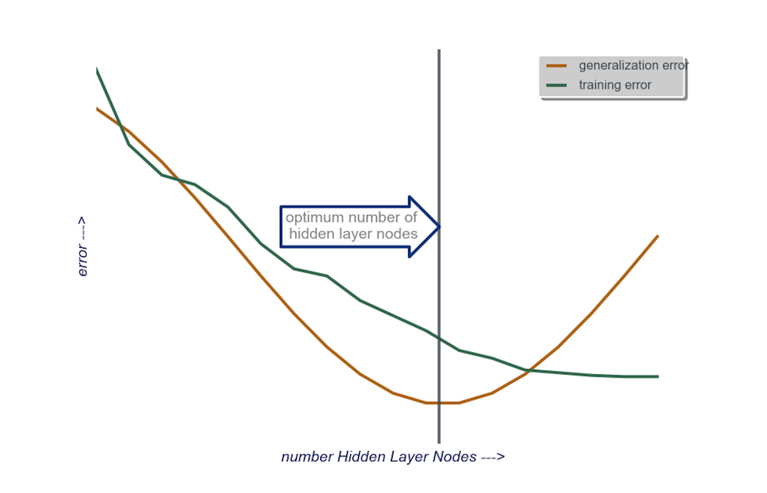
Matt Long Research Notes from an Earlier Semester (II)
A Reasonable But Time Consuming Approach
to start, single hidden layer comprised of a small number of nodes, then add nodes to the Hidden Layer, one at a time, while calculating the generalization error, and training error. When generalization error has dipped and just before it begins to increase again, the number of nodes at that point is good. See figure below.
In practice for quick and dirty non-paying projects. Choose a rule of thumb and then do a couple of runs with more and less nodes and see if the generalization curve is below the training curve with any to see where to jump next. In general a search like above is for expensive projects where we have the time to invest

Slide 19
The Neural Network FAQ
See ftp://ftp.sas.com/pub/neural/FAQ.html#questions
It will change your life. Well maybe not but it’s full of good stuff.

Slide 20
Scott Summerill Notes
One time Scott did some work for an extra point in the HW
See if you do something interesting you live on in future classes…
Go to Scott Notes

Slide 21
Homework
You might ask, why did I invent a new k-Folds example rather than continue the breast cancer example? Simple… Because that’s your homework!
Redo the breast cancer example in R or Python using 5-Fold Cross Validation. Remember to use each sample only once.
Remember a competent answer to 1. is worth 9/10. Ask and answer a challenge question on the topic of Neural Networks or K-Folds for the 10th point. (Doesn’t have to be hard. Just has to be something not covered in class.)

